Slide 1
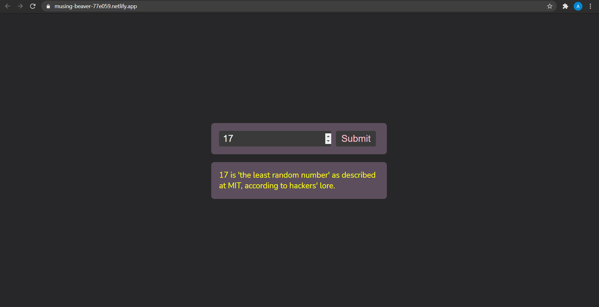
Tech Stacks used in this project:
HTML, CSS, JS, NumberAPI, CorsAPI
Usage of the Web App:
Insert any number in the web app's dialogue box and click submit. It will give you an interesting fact about the number.
Number Information Web App

